Slide 1
DOTS
TRAFFIC PREDICTION
TEAM: DC20018

Slide 2

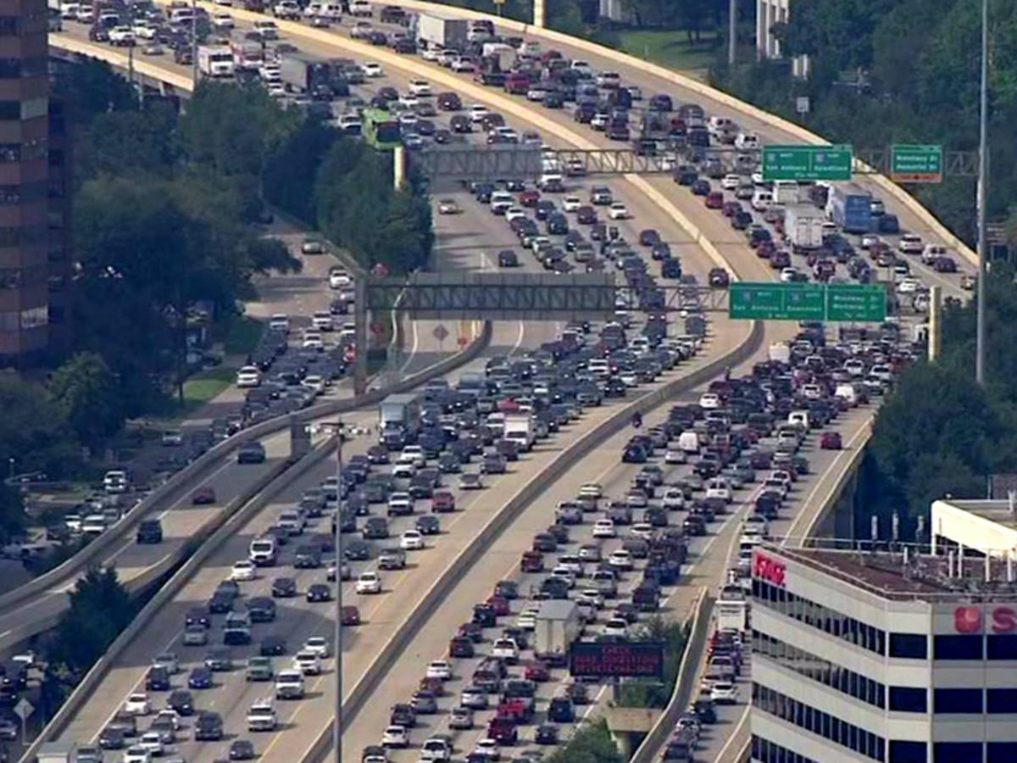
THE PURPOSE OF OUR PROJECT
We don’t want this in our campus!!
Not saying Thanos was right, but we understand!
To avoid potential traffic jams on campus, we need to take action in advance!
We built a predictive model
1. Features we found and put into the model
2. Model performance
3. Model application

Slide 3
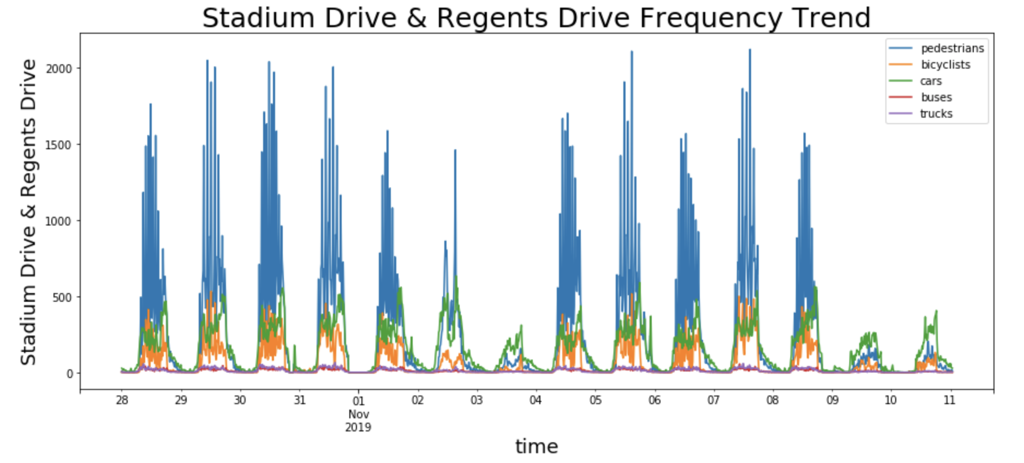
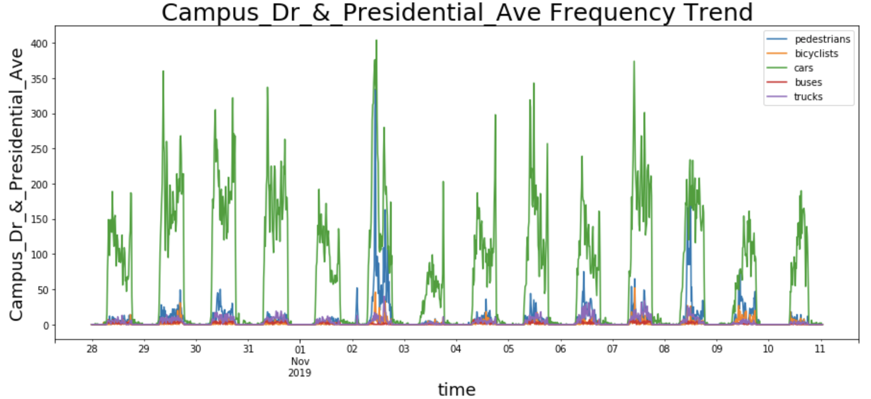
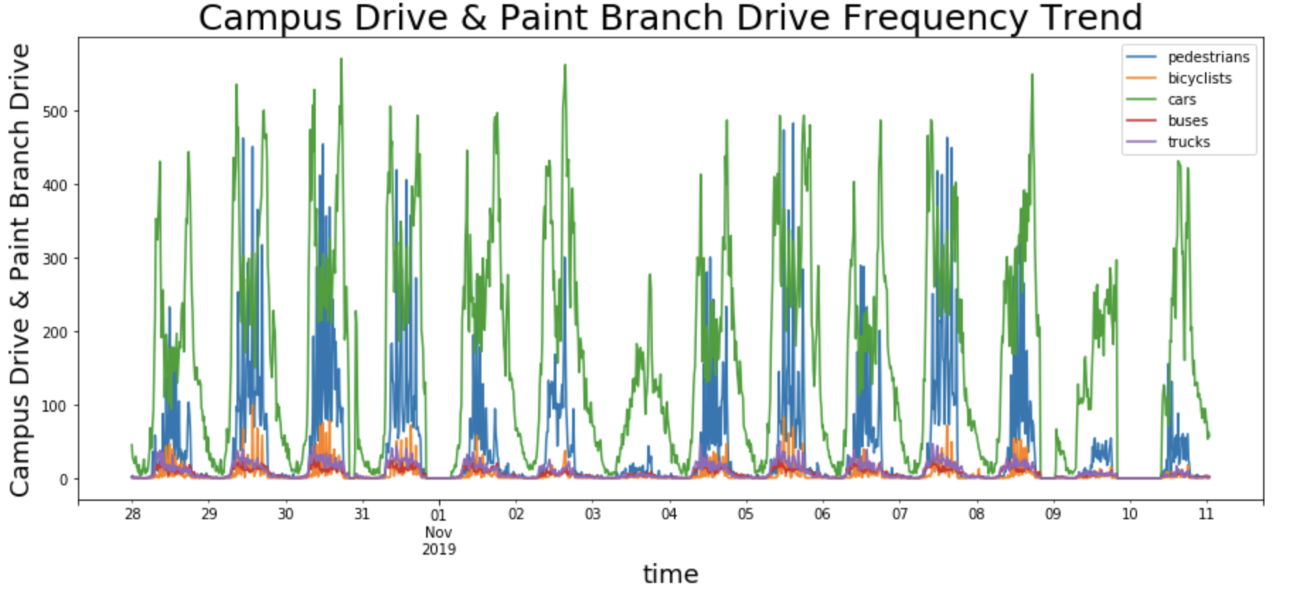
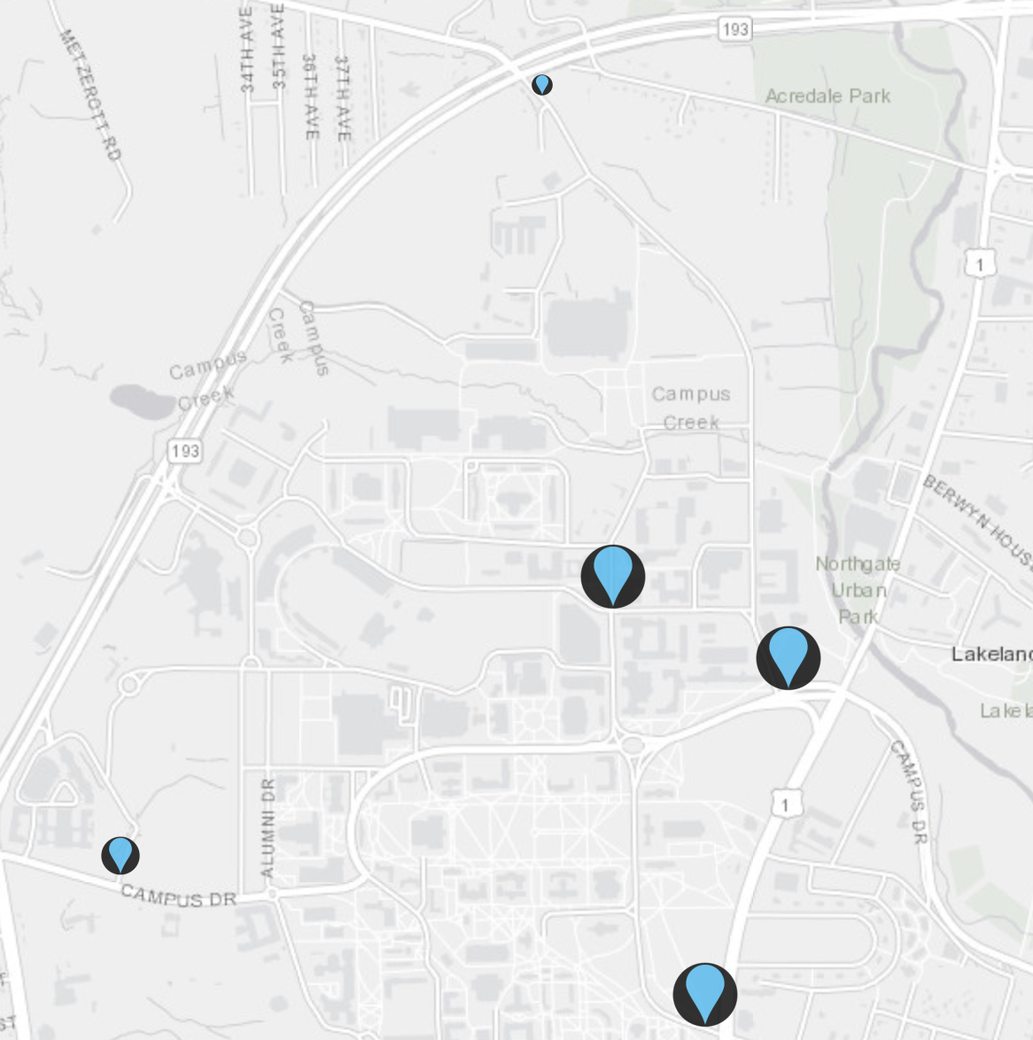
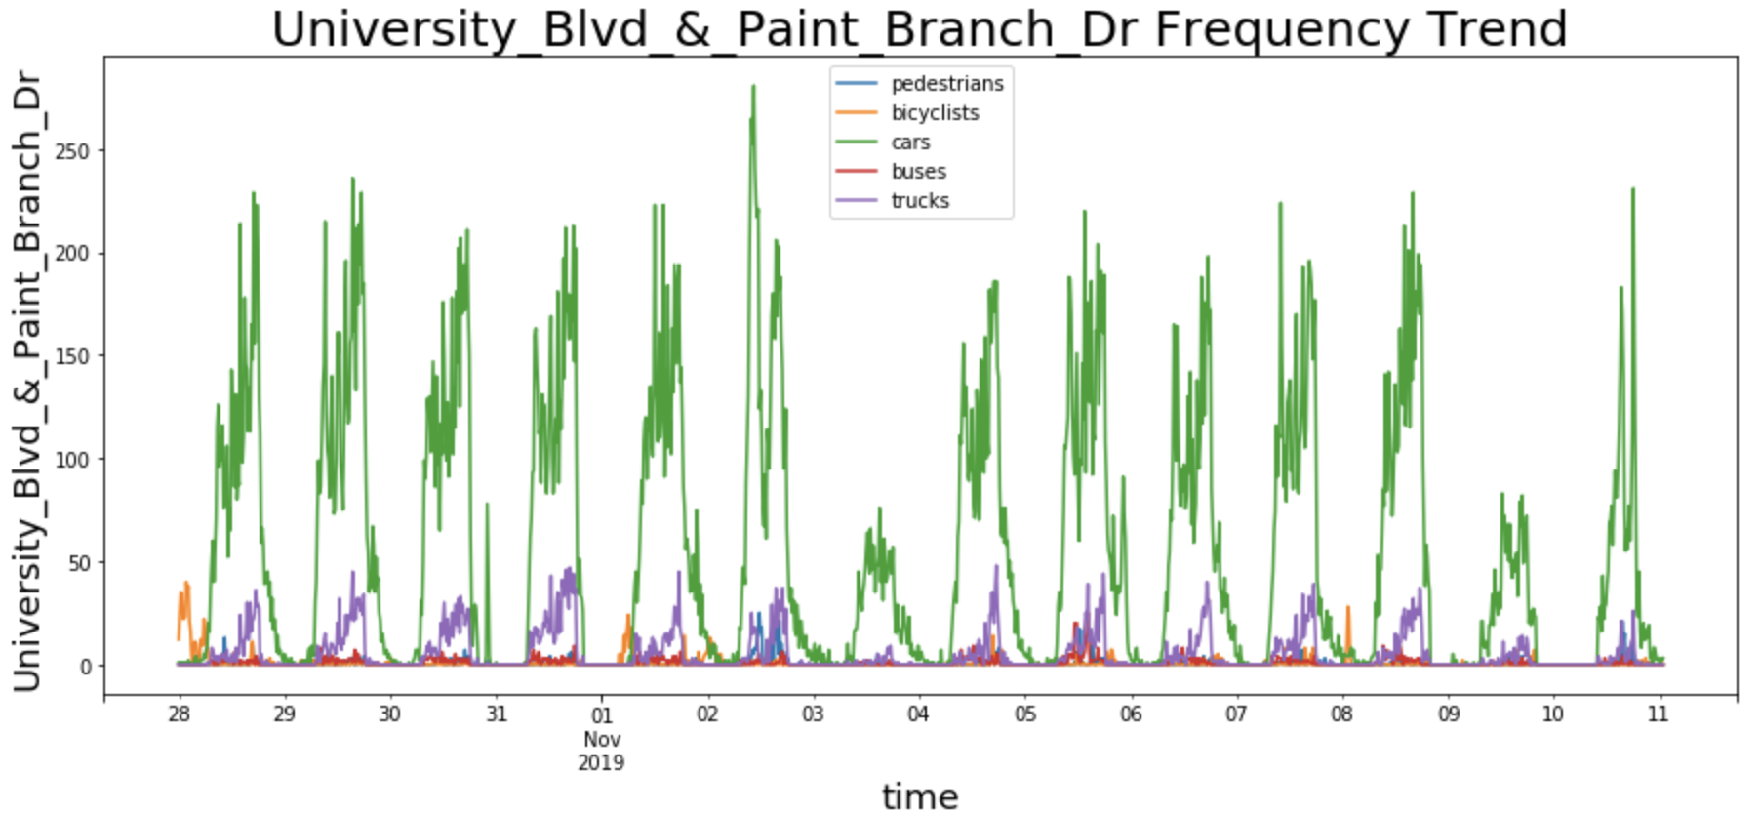
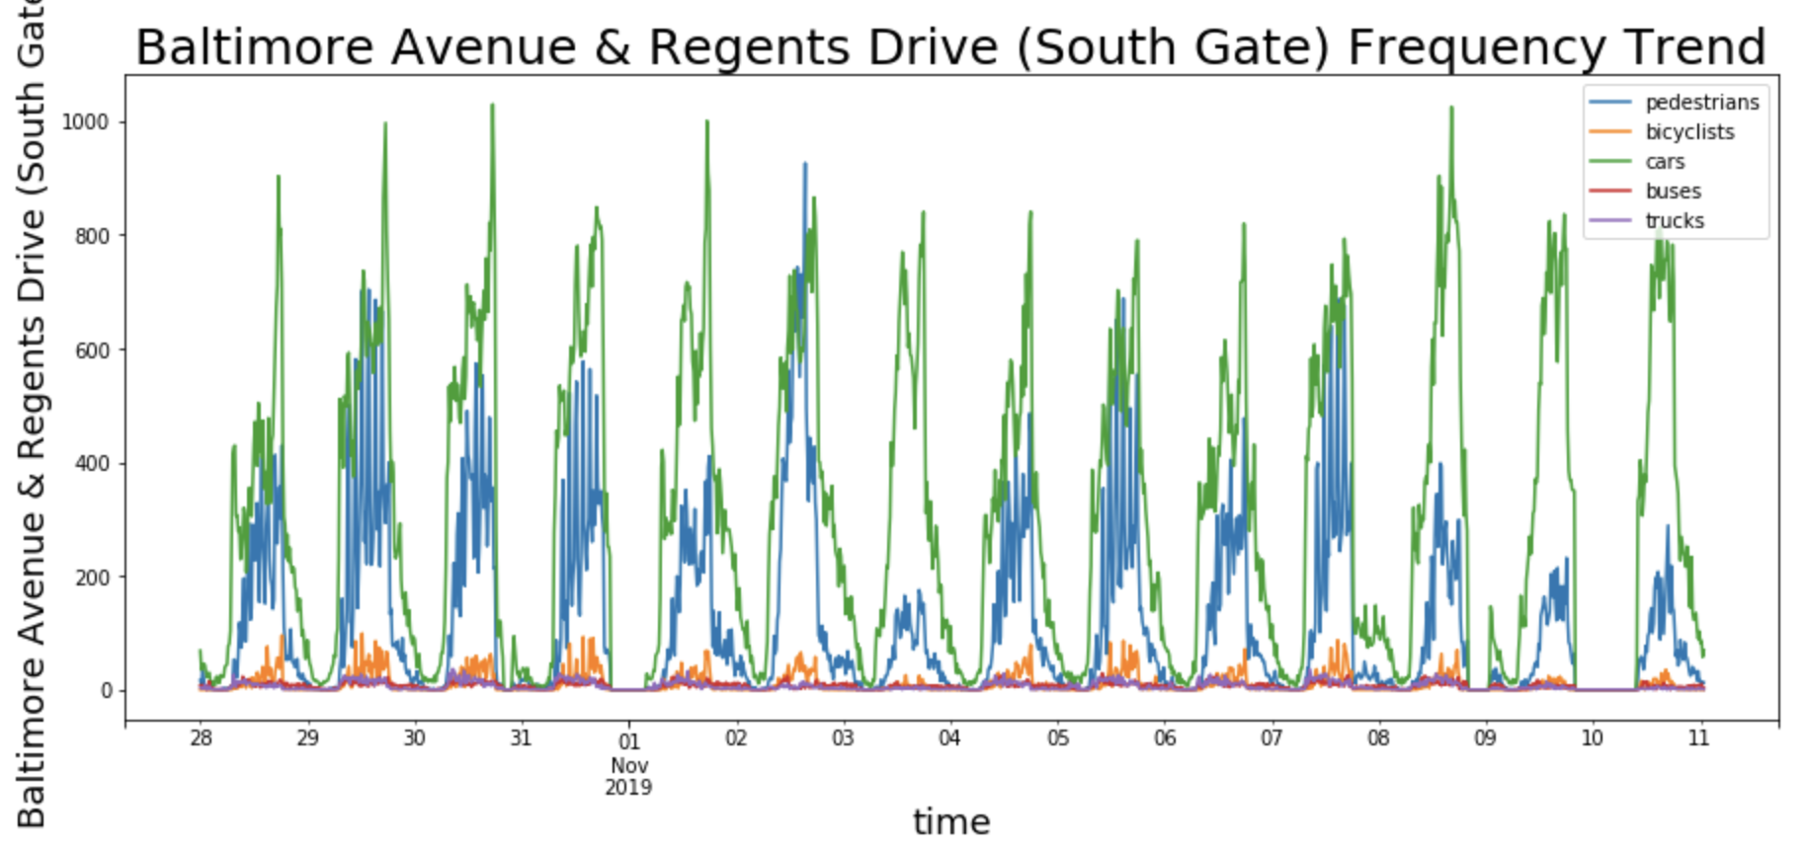
OVERALL TIME TREND
Weekly periodic
Temporary dynamics matter!
Dataset:
count number
5 transportation mode
5 locations
2 weeks

Slide 4
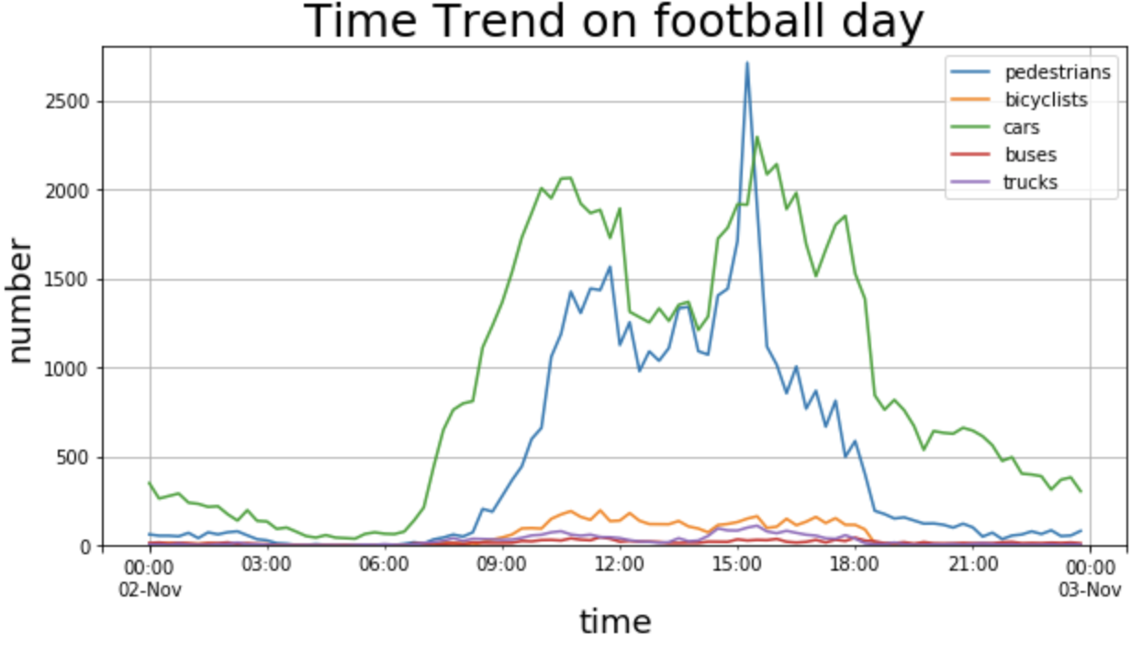
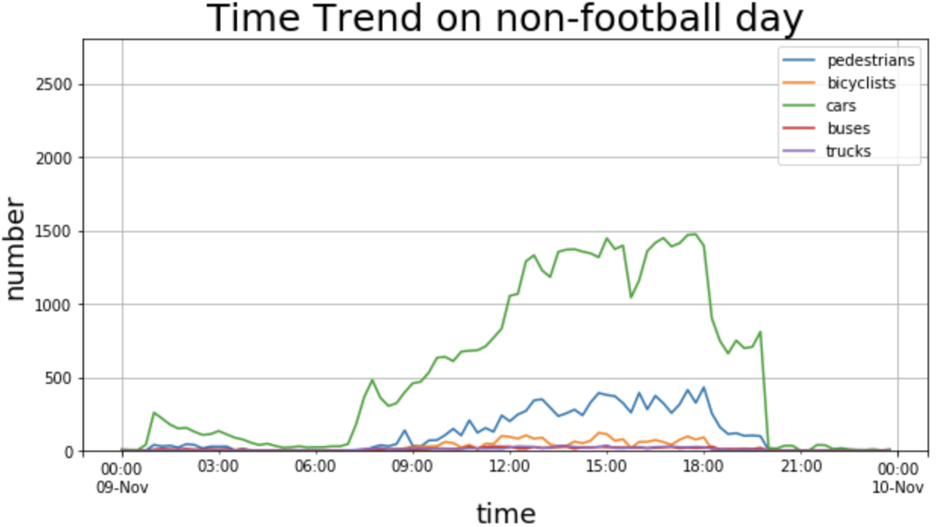
GAME DAY
Football game date: 2019-11-02 Sat
Compare date: 2019-11-09 Sat
Game time: 12:00-15:00 pm
Method: Take number difference, Foreign vehicles
Cars: 1.5 times Pedestrians: 3 times than usual;
A concave
Reach peak earlier(10am) and faster;
Cars reached peak 75 mins earlier;
75min

Slide 5
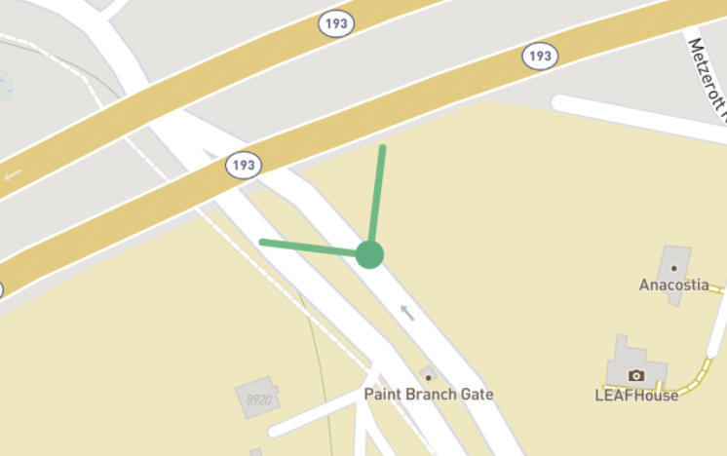
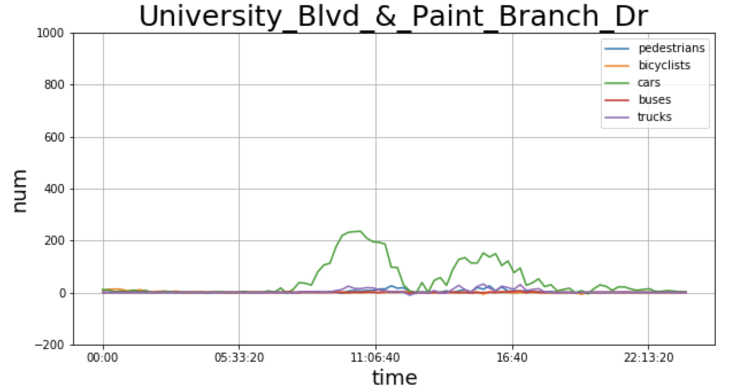
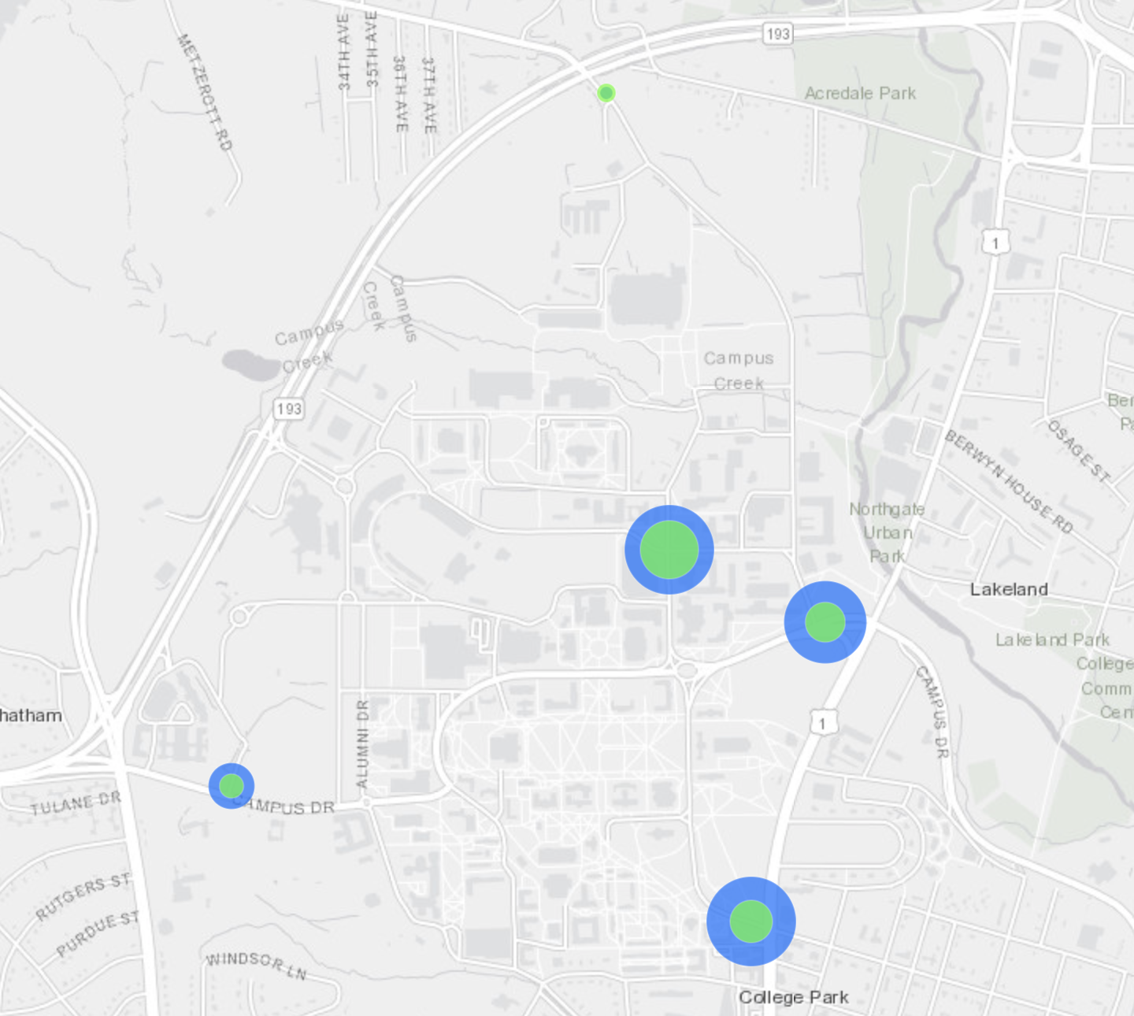
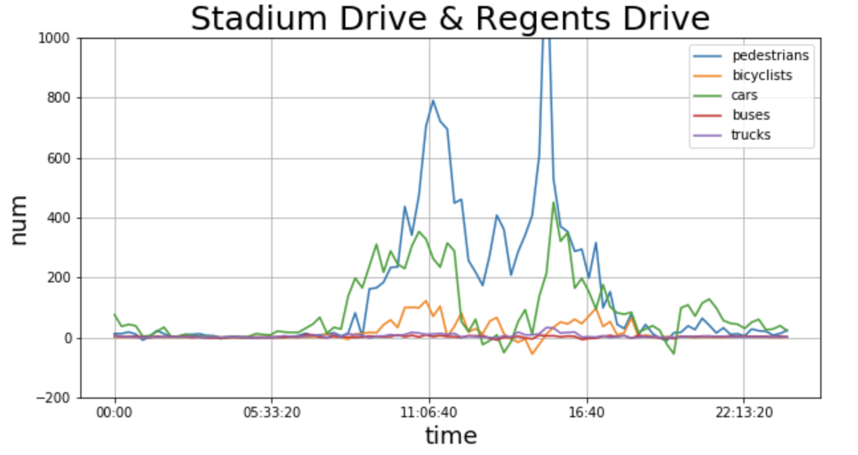
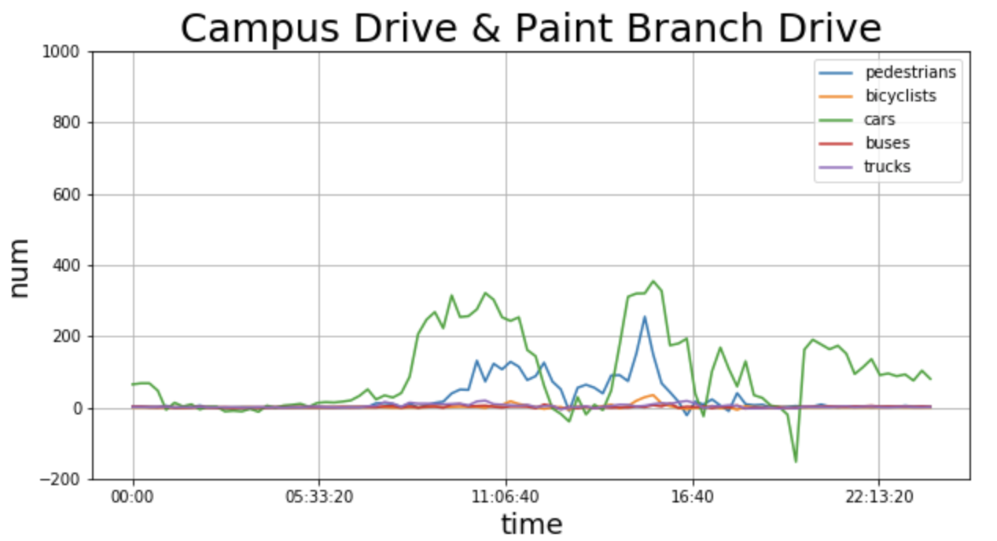
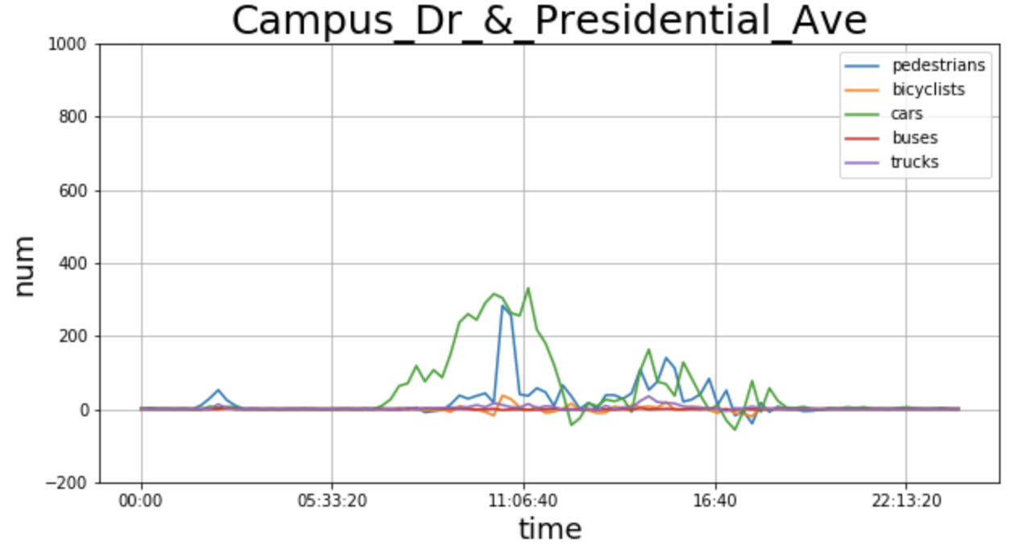
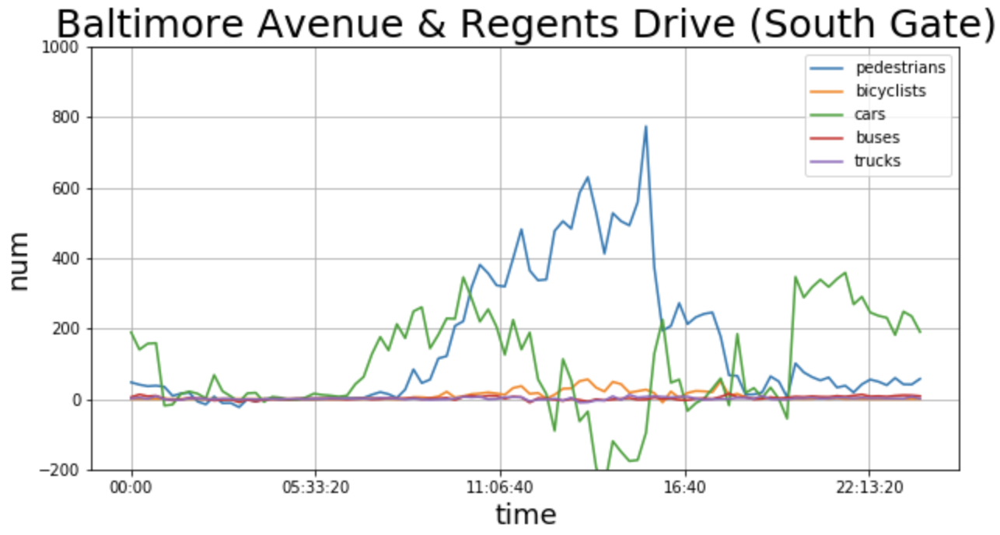
GAME DAY

Slide 6
GAME DAY
Different from others, the number of pedestrians here increases a lot during game time, till the end of the game. And number of cars is much less than usual.
Reason: many people watch game at bars at baltimore avenue, and cars avoid potential traffic here.

Slide 7
GAME DAY
Here, pedestrian traffic reaches its peak at 3pm (1200 more than usual).
Reason: There are many game day parking lots around here and there is a major bus stop near here.

Slide 8
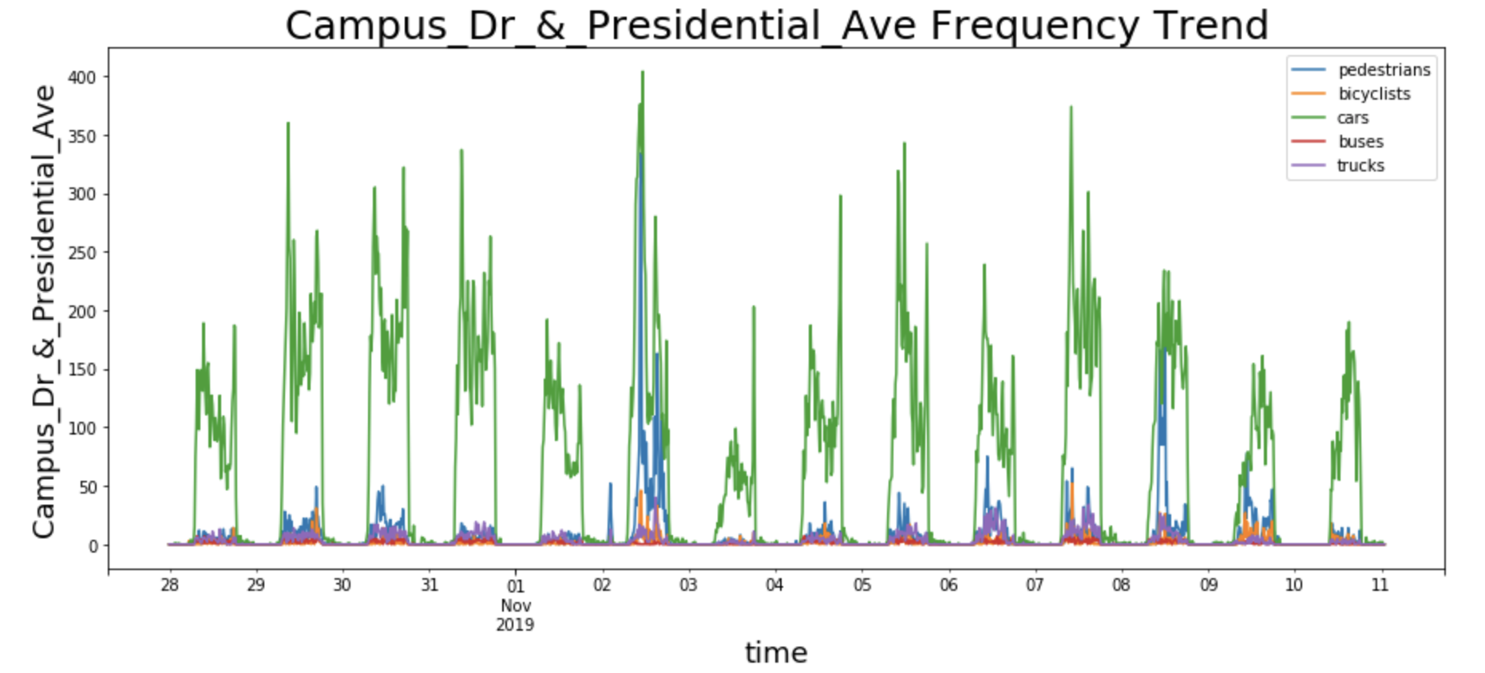
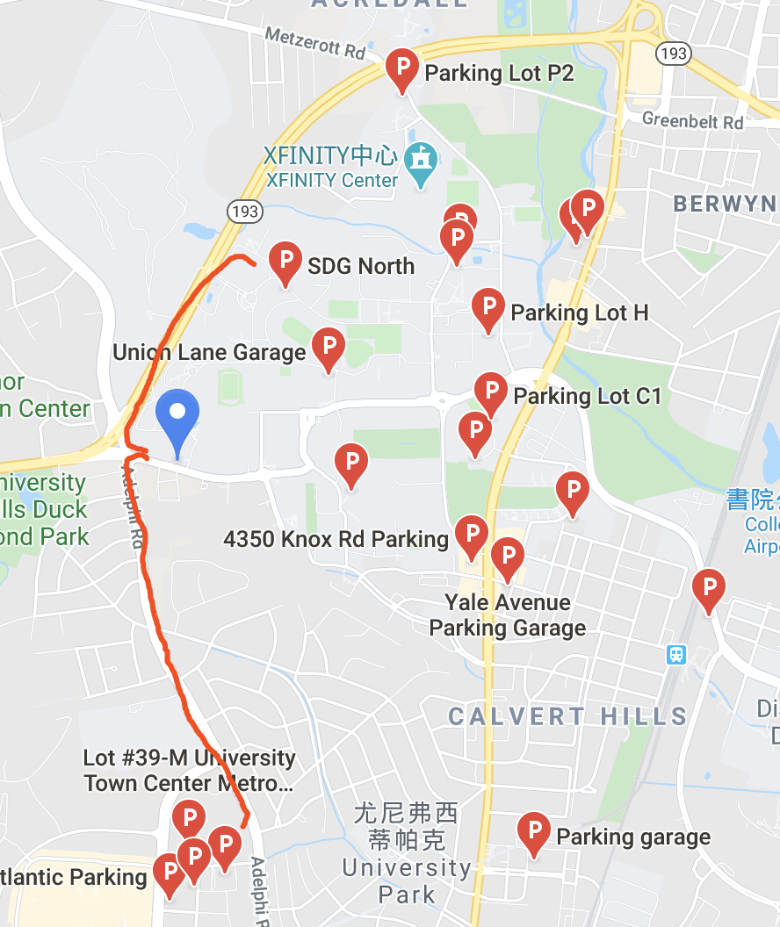
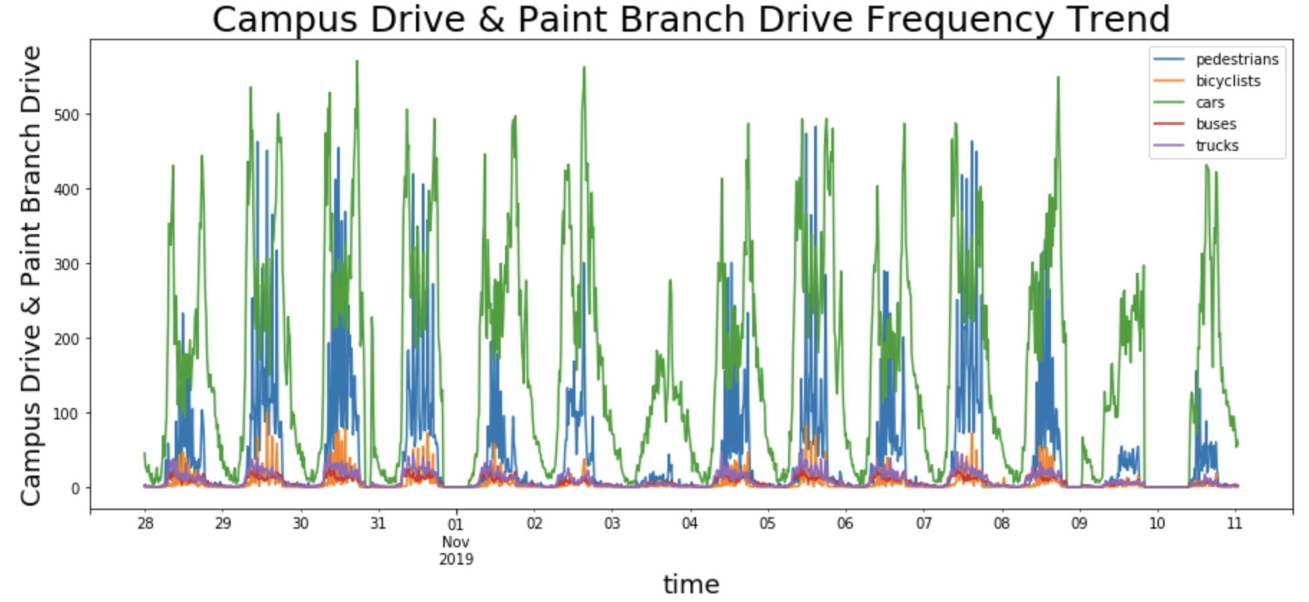
GAME DAY

Slide 9
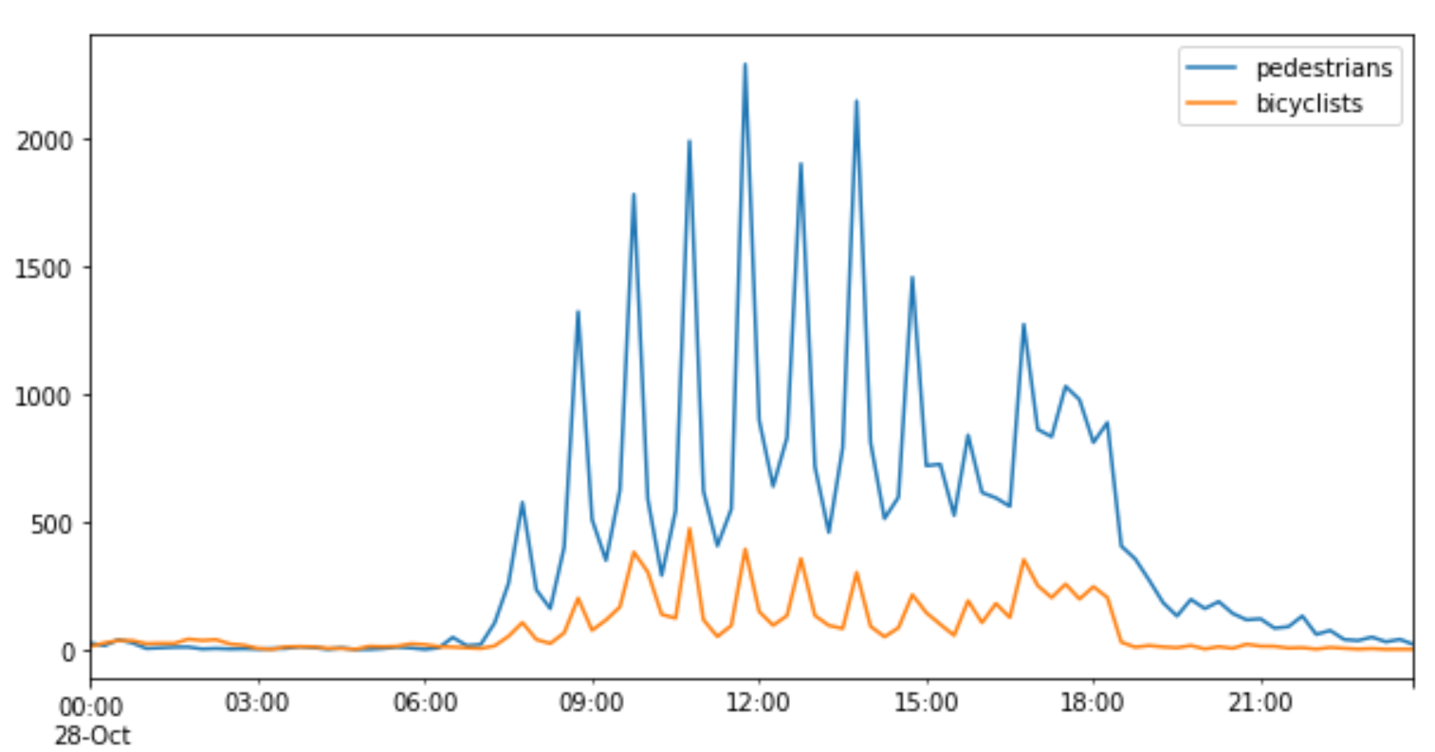
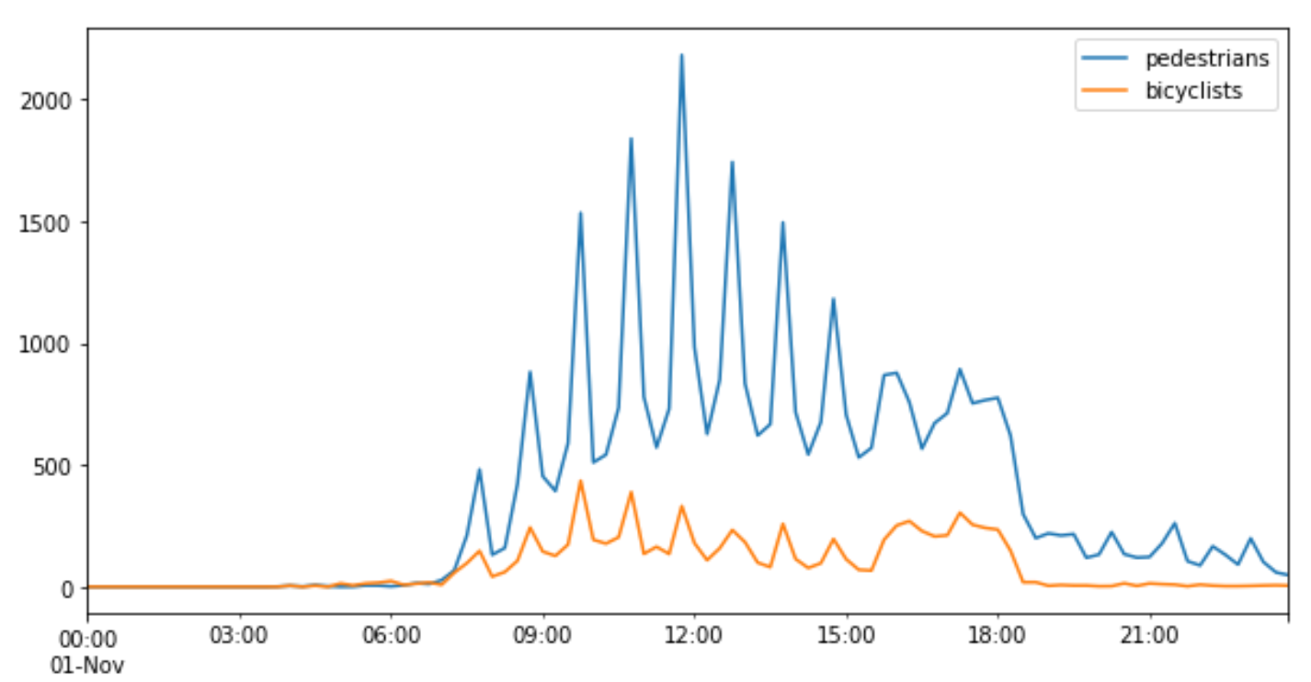
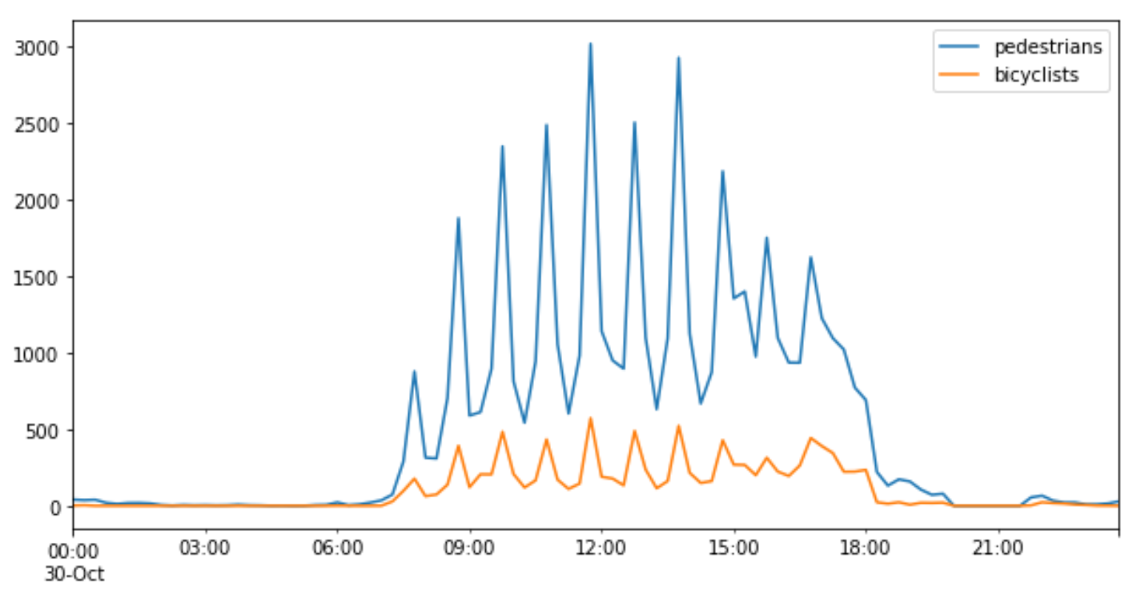
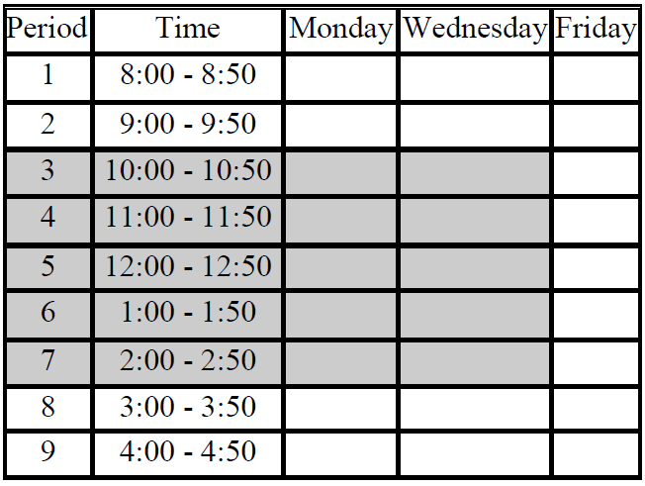
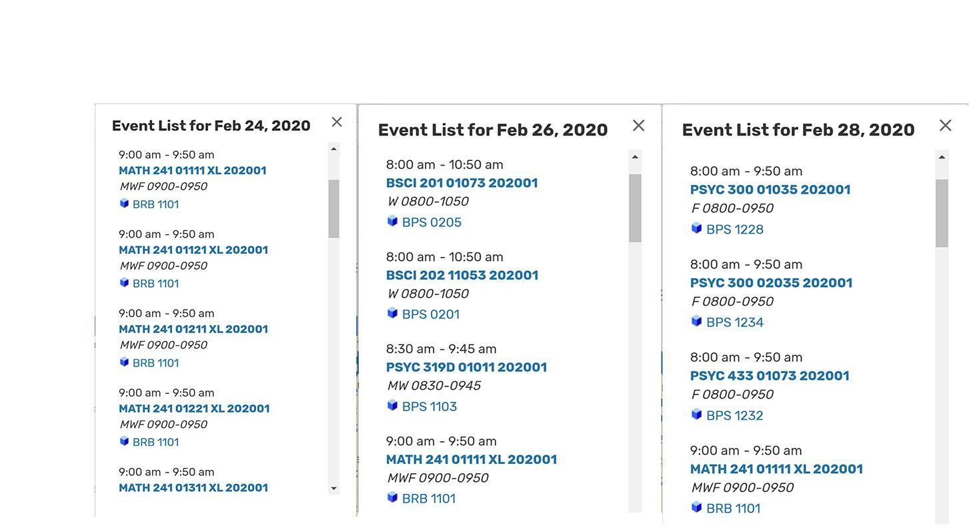
CLASS SCHEDULE (MON, WED, FRI)
Notes:
There is a striking resemblance between Mondays and Wednesdays and Fridays where class duration is of 50 minutes starting
around 8am. All the peak points observed are exactly 15 minutes before the class starts i.e at 8:45 , 9:45, 10:45, 11:45 and so
on.

Slide 10
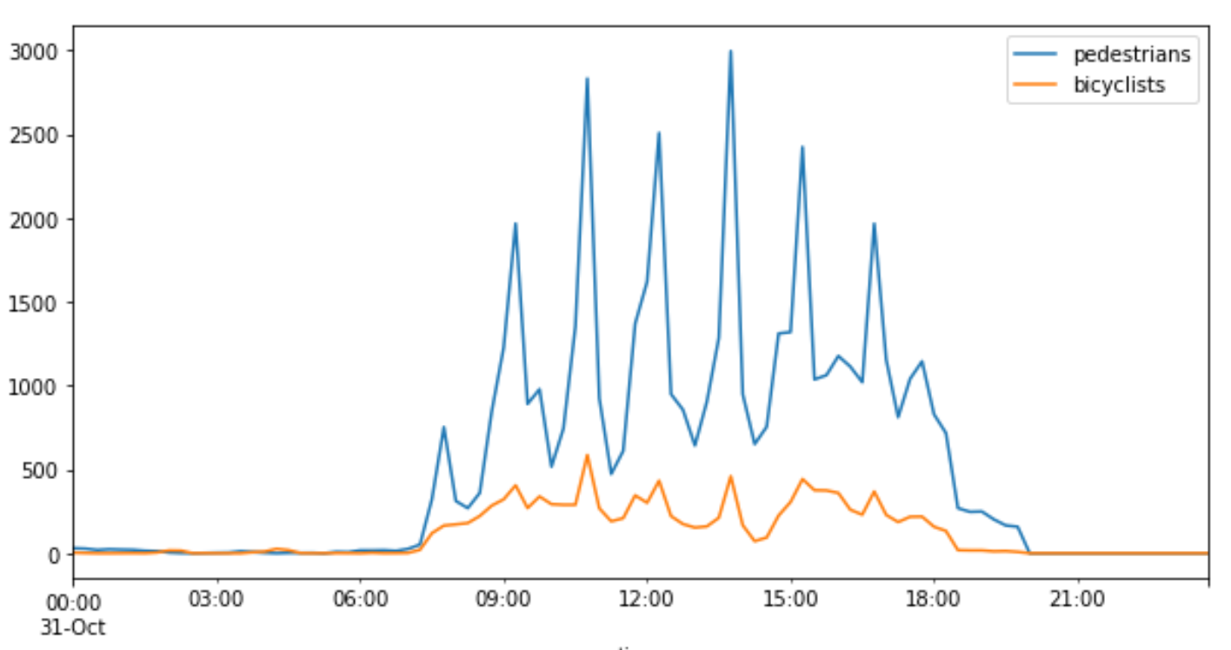
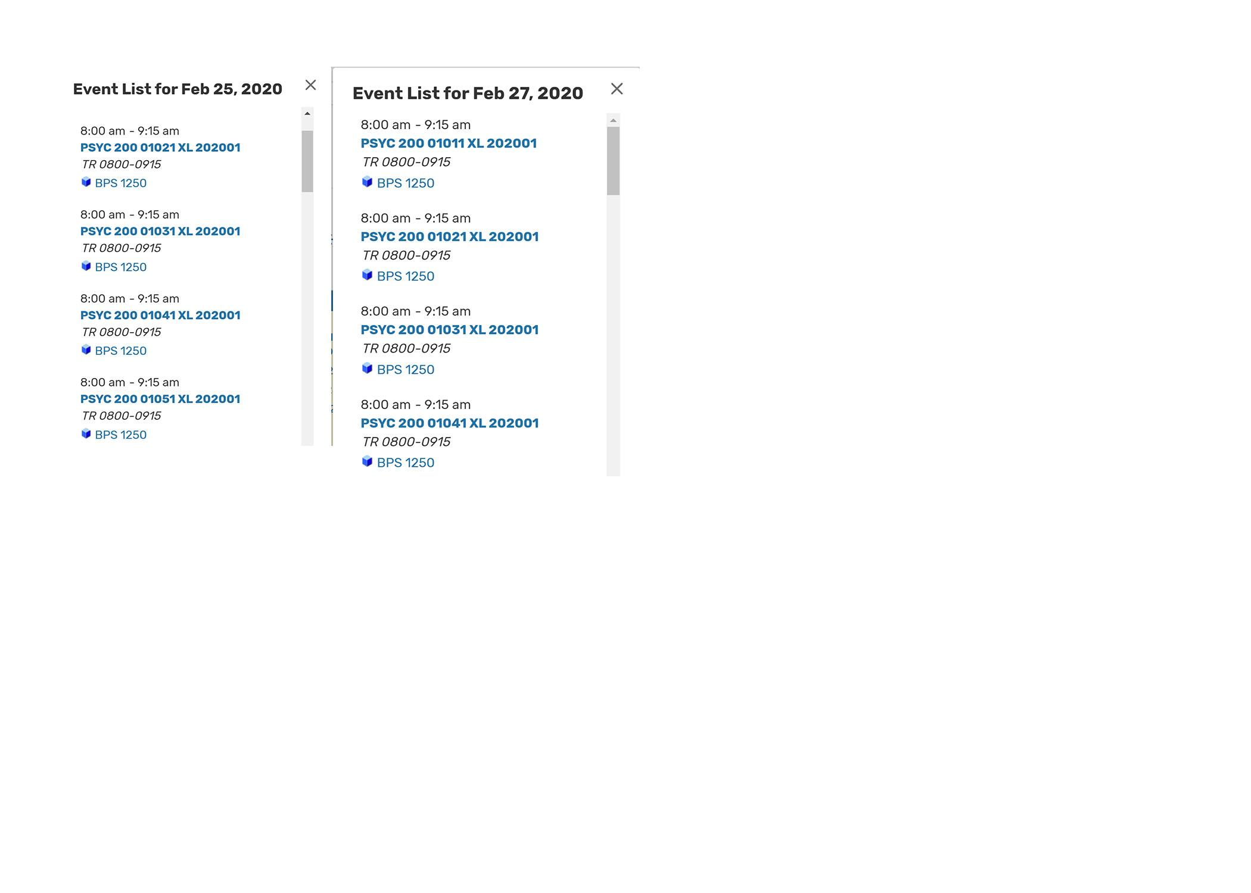
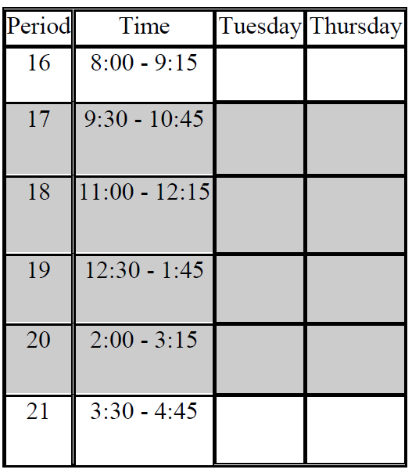
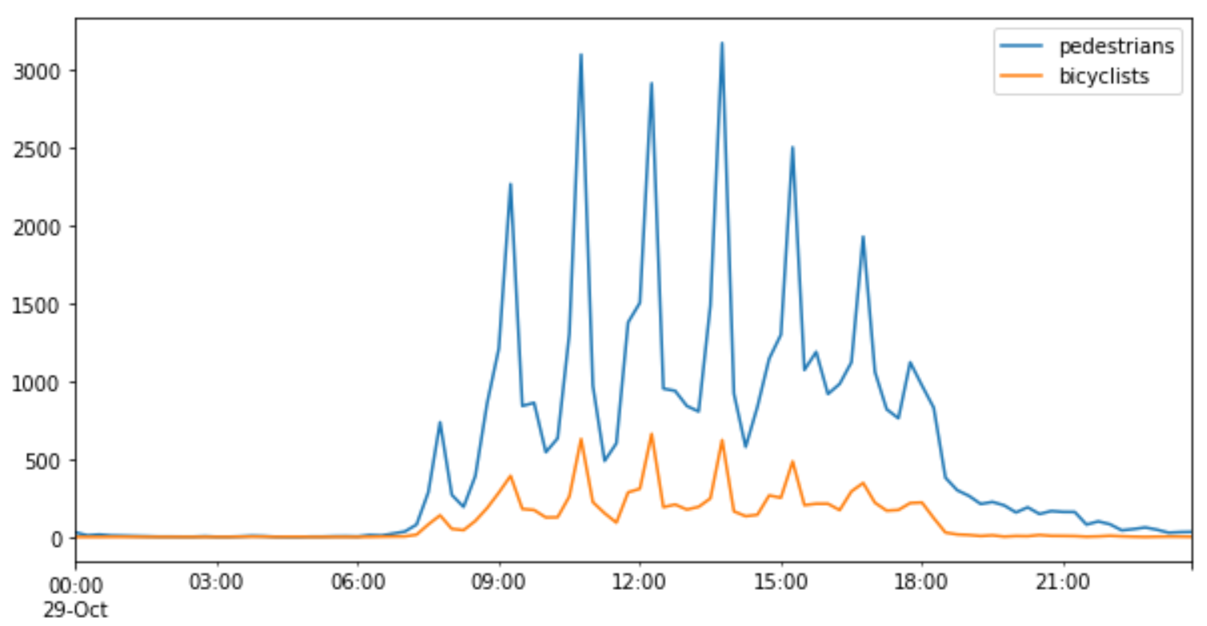
CLASS SCHEDULE (TUE, THURS)
Notes:
The same resemblance is observed for Tuesdays and Thursdays where class duration is of 75 minutes, starting from 8am.
All the peak points observed are at 9:15, 10:45, 12:15, 1:45 and so on, these are just before the class starts.

Slide 11
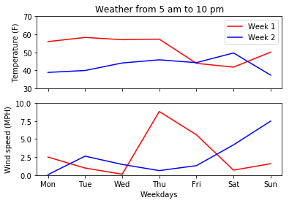
WEATHER
No precipitation
Hard to separate from confounders with limited data
Not enough data for wind uncorrelated with temperature
Comparison of most distinct weather days
Notes:
In mornings, we found that temperature accounted for more bikes and pedestrians generally, but in the hours right before the first class, up to a 3.5x difference for pedestrians and a 5.5x difference for bikes.

Slide 12
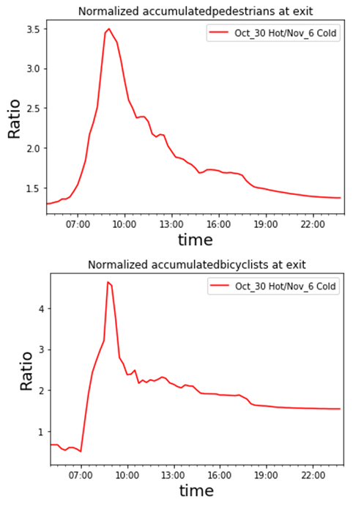
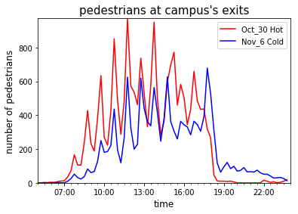
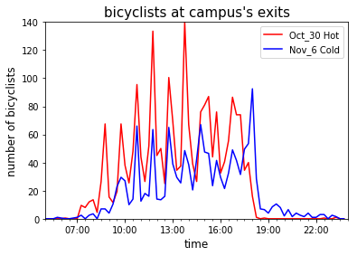
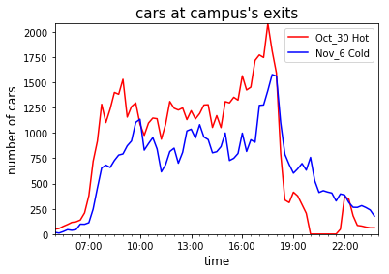
WEATHER

Slide 13
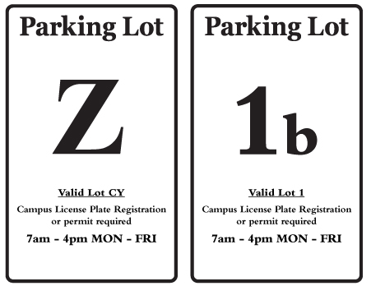
PARKING POLICY
Statistically insignificant difference for cars
Difference for pedestrians, bikes, etc. essentially correlates to class schedule, which is not independent of parking hours.

Slide 14
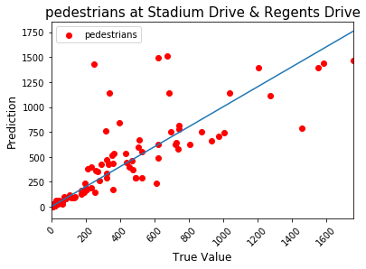
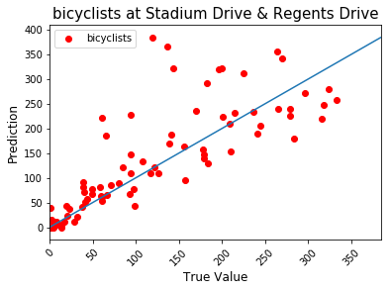
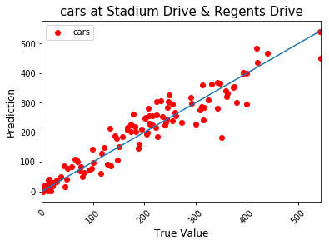
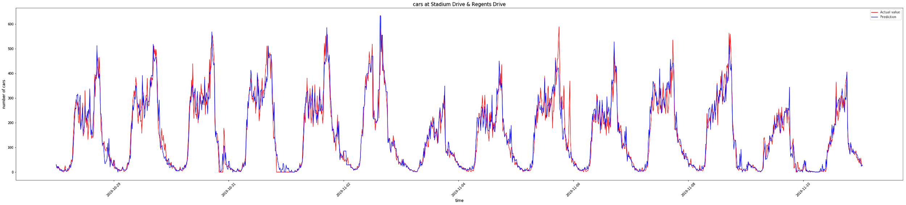
PREDICTIVE MODEL (Performance)
R2=0.701
R2=0.706
R2=0.928

Slide 15
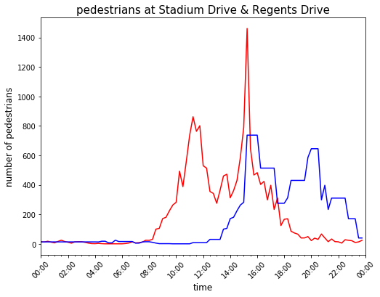
PREDICTIVE MODEL (What if the game is prolonged?)
12:00 to 16:00
4h
3 h -> 4h
3h

Slide 16
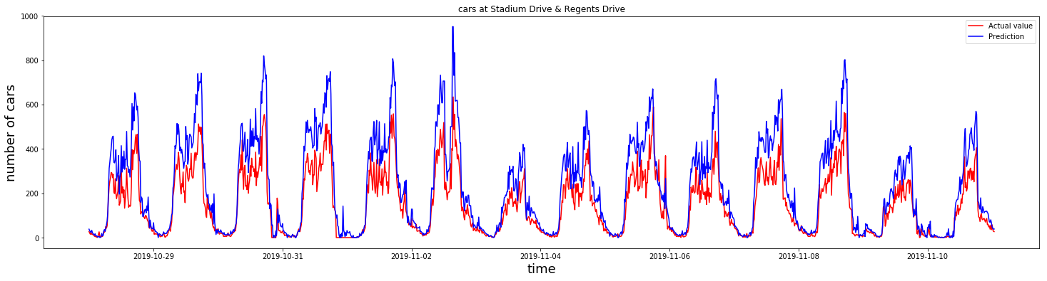
PREDICTIVE MODEL (What if more student get enrolled?)
1.5 times cars

Slide 17
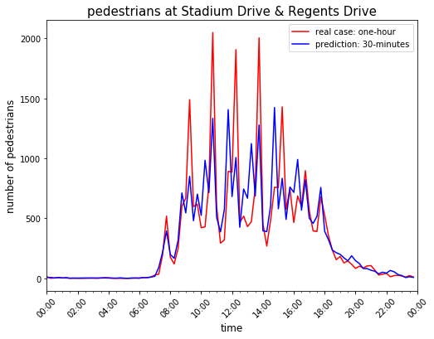
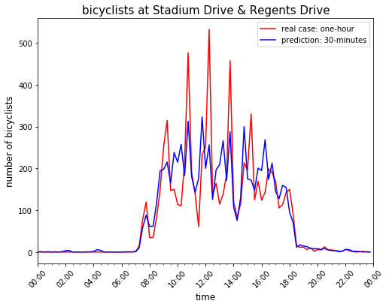
PREDICTIVE MODEL (Class Schedule)
1h to 30 mins
Have the class timings be a mixture of 50 mins and 75 mins on the same day on different departments.

Slide 18
Future Works
Collect more data to support our suggestions, such as the reason for student’s low attendance in cold weather. (Hospital data)
More data on football game days to make our model for game day more robust.
Collect student population and the number of car on the road over years.

Slide 19
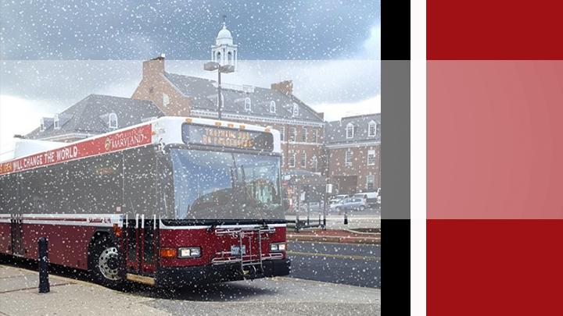
THANK YOU!

Slide 20
Extra slides ahead

Slide 21
Suggestions
1- Hot Lanes
2- Build Connected pathways
3- Carpooling
4- Advocating walking and Biking

Slide 22
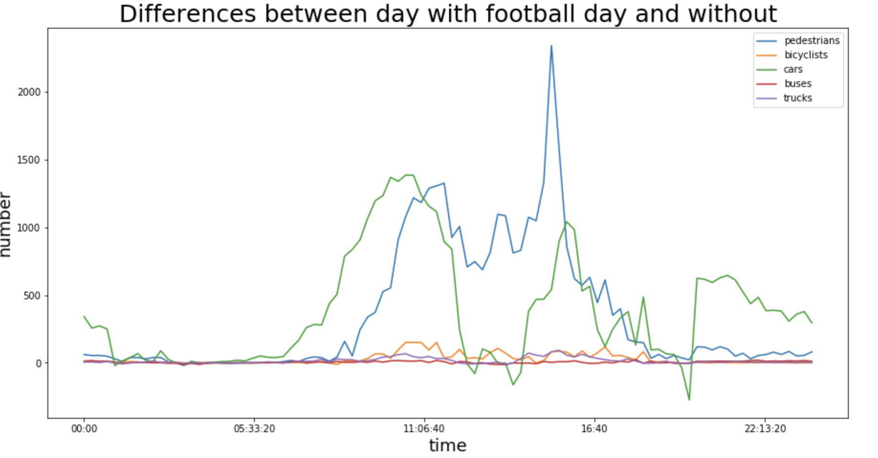
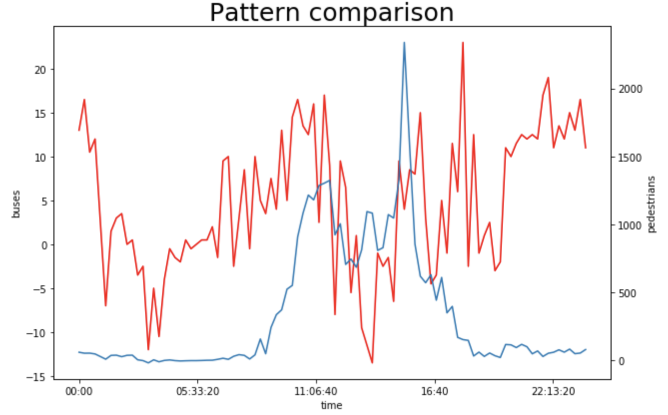
ACTIVITY
Football game date: 2019-11-02 Sat
Compare date: 2019-11-09 Sat
Game time: 12:00-15:00 pm
Method: Take number difference, Foreign vehicles
Cars: 1.5 times Pedestrians: 3 times than usual; Reach peak earlier(10am); A concave
75min

Slide 23
ACTIVITY
Before the beginning of game, car traffic was higher than usual, might because they couldn't find parking spot, then went out and park along the road

Slide 24
ACTIVITY
3
1
After the end of game(around 3pm), more cars exit campus from Campus Drive & Paint Branch Drive rather than south gate,the third is University_Blvd_&_Paint_Branch_Dr. Campus Drive & Paint Branch Drive has higher kurtosis than University_Blvd_&_Paint_Branch_Dr.
2

Slide 25
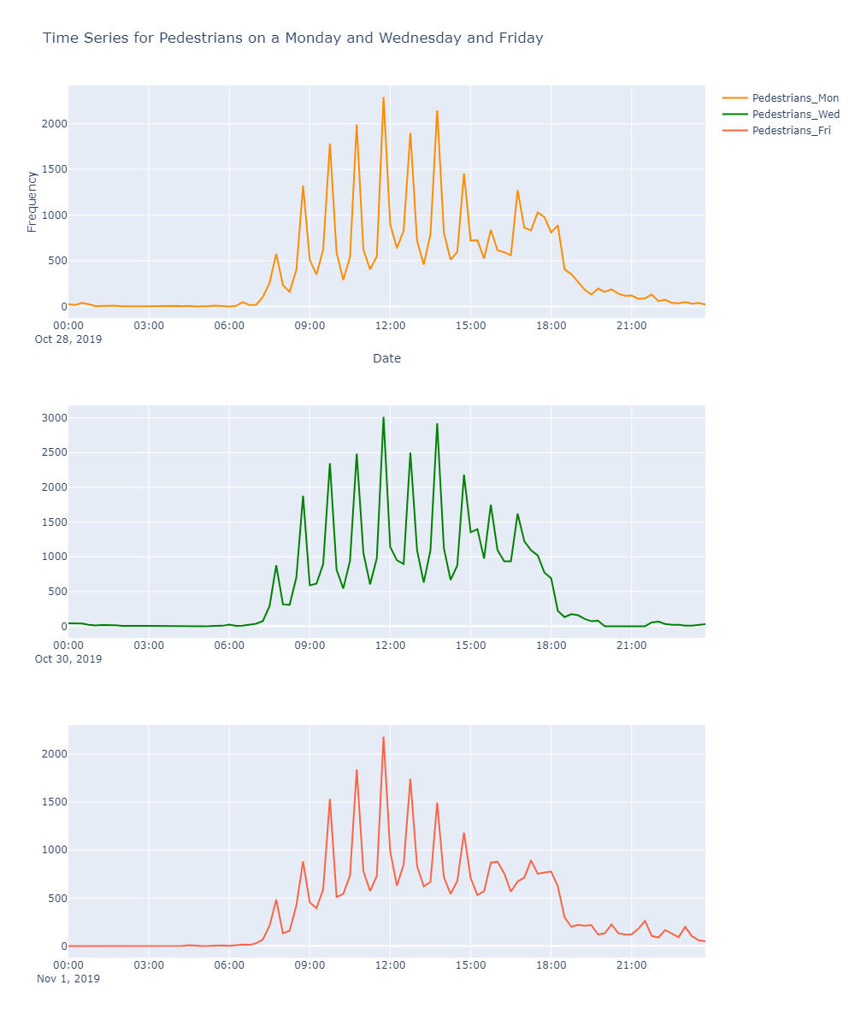
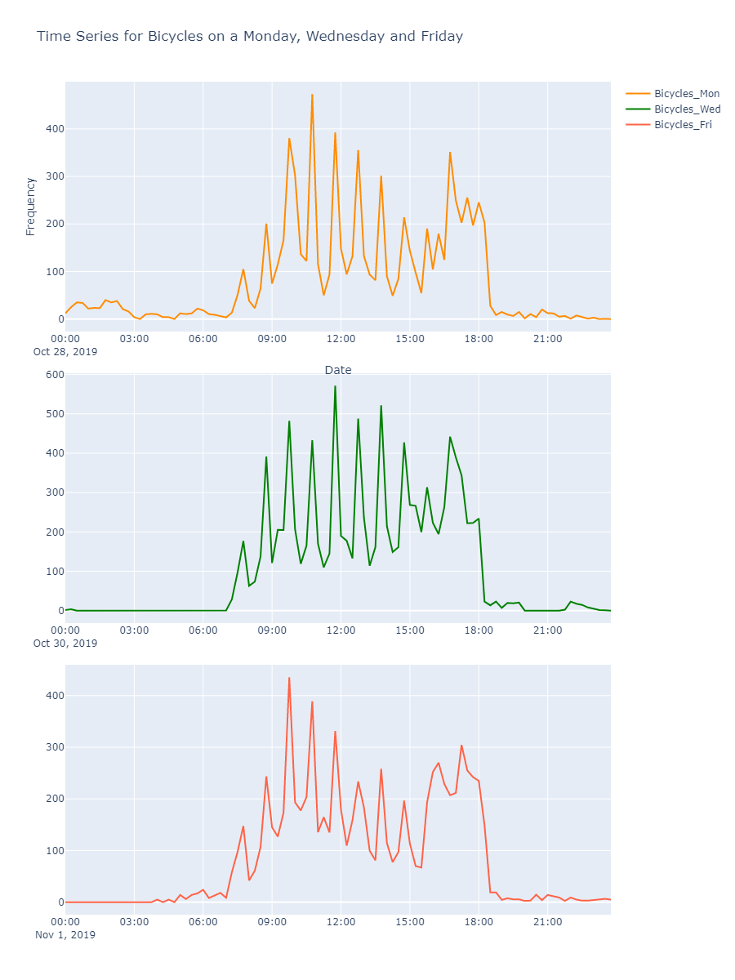
CLASS SCHEDULE (MON, WED, FRI)
Pedestrians
Bicyclists
Notes:
There is a striking resemblance between Mondays and Wednesdays and Fridays where class duration is of 50 minutes starting
around 8am. All the peak points observed are exactly 15 minutes before the class starts i.e at 8:45 , 9:45, 10:45, 11:45 and so
on.

Slide 26
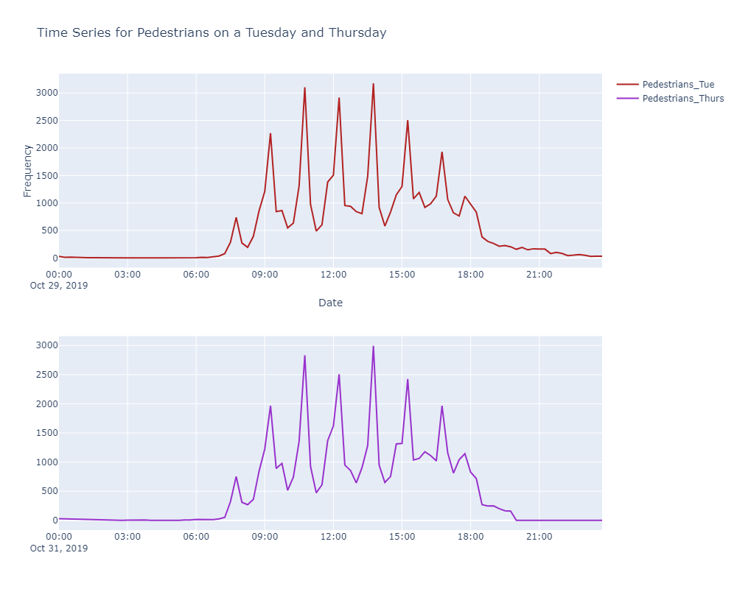
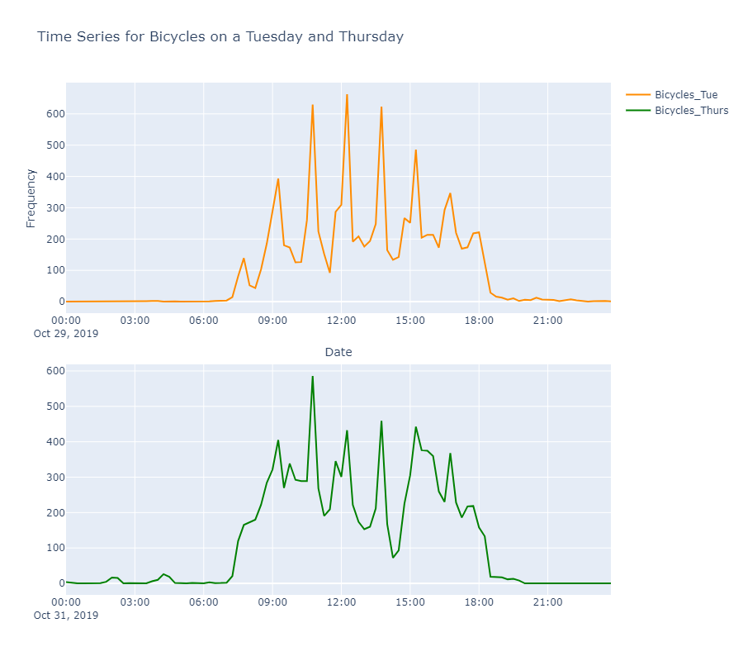
CLASS SCHEDULE (TUE, THURS)
Notes:
The same resemblance is observed for Tuesdays and Thursdays where class duration is of 75 minutes, starting from 8am.
All the peak points observed are at 9:15, 10:45, 12:15, 1:45 and so on, these are just before the class starts.

Slide 27
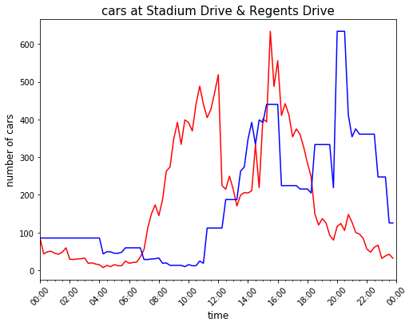
PREDICTIVE MODEL (What if the game is prolonged?)
12:00 to 16:00
4h
12:00 to 16:00
4h
3 h -> 4h
3h
3 h -> 4h
3h

